Slide 1

Open Science & FAIR
Introduction to Data Management Practices course
NBIS DM Team
data@nbis.se
https://nbisweden.github.io/module-open-science-dm-practices/index.html

Slide 2
Open Science
Make scientific research and its dissemination accessible to all levels of society.
Open methodology
Open source
Open data
Open access
Open peer review
Open educational resources
Notes:
By Open Science we mean the movement to make scientific research and its dissemination accessible to all levels of society. Principles of open science are:
Open methodology
Open source
Open data
Open access
Open peer review
Open educational resources
Of these, Open data and Open source are some of the main drivers for good Data Management practices.

Slide 3
Reasons for Open Science
What do you think are reasons for Open Data?
Notes:
What do you think are reasons for Open Data? Discuss with your neighbours.

Slide 4
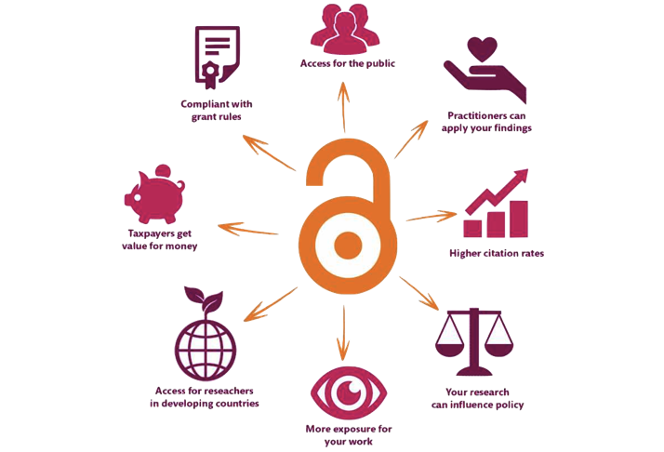
Open Data
Democracy and transparency
Publicly funded research data should be accessible to all
Published results and conclusions should be possible to check by others
Research
Enables others to combine data, address new questions, and develop new analytical methods
Reduce duplication and waste
Innovation and utilization outside research
Public authorities, companies, and private persons outside research can make use of the data
Citation
Citation of data will be a merit for the researcher that produced it
Notes:
See slide

Slide 5
Ethical?
Doing “sloppy” science & not being open and transparent
Waste of resources
Contributing to the current research credibility crisis
Contributing to the current reproducibility crisis
Harming the profession
Harming public trust in research
My take of material by Rochelle Tractenberg “Unexpected Ethical Challenges in Bioinformatics and Genomics.”
Notes:
It can be argued that not being transparent about the data and methods that are used to reach the scientific conclusions that you publish, is not ethical.
It can be considered to be a waste of resources, potentially harming the profession, public trust in research, and contributing to the current research credibility/reproducibility crisis.

Slide 6
Crisis?
Do you think we have a credibility and/or reproducibility crisis?
If so, what are some of its causes?
Notes:
Let learners discuss for 5 minutes
Some causes:
Credibility
Research fraud has been exposed
The scientific process is not understood
…
Reproducibility
Methods unclear
Software not available
Data not available
Researchers don’t get academic credit for being transparent
You can build a CV faster when being sloppy(?)
…

Slide 7
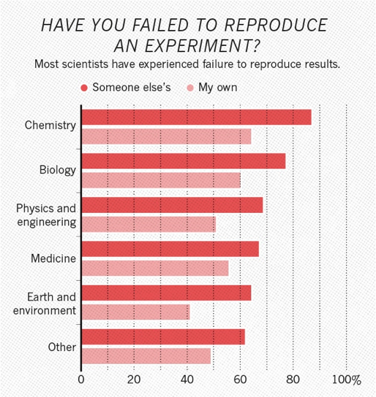
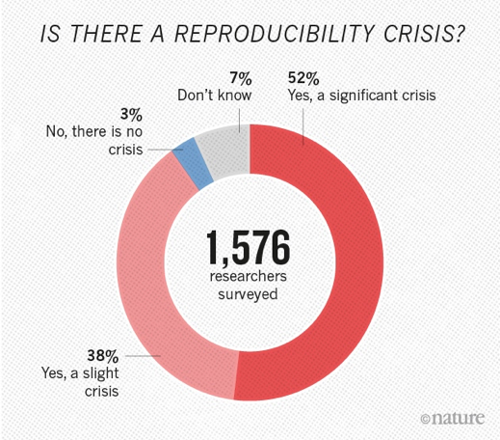
A reproducibility crisis
[1] "1,500 scientists lift the lid on reproducibility". Nature. 533: 452–454
[2] Begley, C. G.; Ellis, L. M. (2012). "Drug development: Raise standards for preclinical cancer research". Nature. 483 (7391): 531–533.
Notes:
When surveyed, the research community to a large extent seem to agree to that there is a reproducibility crisis.

Slide 8
A reproducibility crisis
Reproduction of data analyses in 18 articles on microarray-based gene expression profiling published in Nature Genetics in 2005–2006:
Can reproduce…
…in principle
Software not available
…with some discrepancies
Cannot reproduce
Data not available
…from processed data with some discrepancies
Methods unclear
Different results
…partially with some discrepencies
Summary of the efforts to replicate the published analyses.
Adopted from: Ioannidis et al. Repeatability of published microarray gene expression analyses.
Nature Genetics 41 (2009) doi:10.1038/ng.295
Notes:
Many studies have been done on Reproducibility of published research, and regardless of scientific domain, it seems that more or less half of the publications looked at are not possible to reproduce.
A large part of those are because the underlying data is not available or not understandable. Often it is also not possible to understand how the analyses were done.

Slide 9
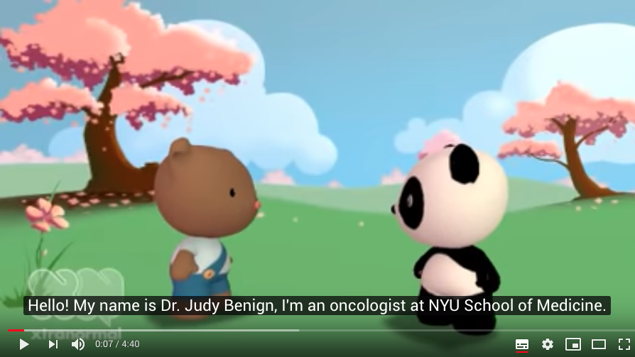
Data Management Snafu
https://www.youtube.com/watch?v=N2zK3sAtr-4

Slide 10
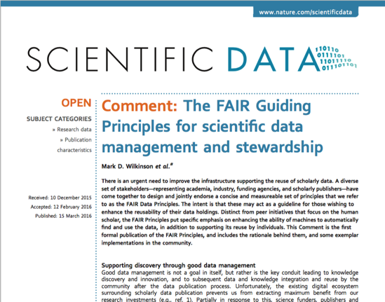
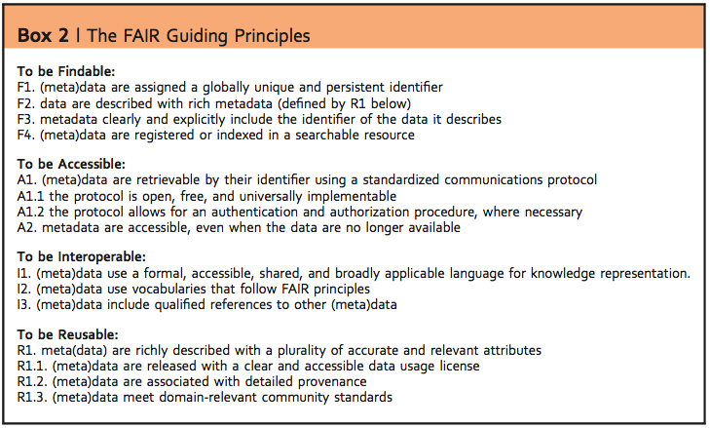
FAIR
To be useful for others data should be
FAIR - Findable, Accessible, Interoperable, and Reusable … for both Machines and Humans
Wilkinson, Mark et al. “The FAIR Guiding Principles for scientific data management and stewardship”. Scientific Data 3, Article number: 160018 (2016) http://dx.doi.org/10.1038/sdata.2016.18
^{DOI: 10.1038/sdata.2016.18}
Notes:
To try to guide the scientific community on how to ensure that the research data is useful for others in the digital age, the FAIR principles were published in 2016.
“To be useful for others data should be FAIR - Findable, Accessible, Interoperable, and Reusable … for both Machines and Humans”
So what this mean?

Slide 11
Findable
Data have a globally unique persistent identifier
e.g. a DOI, database accession number, etc
Data are described by metadata
Information that explains the data
Data and metadata are findable in a search resource
There must be ways of searching for the data
Notes:
See slide

Slide 12
Accessible
Data is retrievable through a standardised communication protocol (open, free, allowing authentication & authorisation where necessary)
e.g. http, sftp, etc
Metadata are accessible, even if data is no longer available
Information about the data can be found even if data is no longer available
Notes:
See slide

Slide 13
Interoperable
Metadata use a formal, accessible, shared language for knowledge representation
Metadata is available in a form that even a computer can make use of
Metadata use vocabularies that follow the FAIR principles
Standardised ways of capturing information about the data (that are in themselves FAIR)
Metadata include qualified references to other metadata
If the data relies on other data, there must be links to those
Notes:
See slide

Slide 14
Reusable
Data have a clear data usage license
It is obvious under what conditions the data can be reused
Metadata are associated with detailed provenance
The metadata is detailed enough to understand for what research questions it is relevant to reuse
Metadata meet domain-relevant community standards
Metadata is described according to existing standards in the research field
Notes:
See slide

Slide 15
FAIR
Both humans and machines are intended users of data
The principles are not necessarily about open data
“As open as possible, as closed as necessary”
FAIRness is not something absolute
Different levels of FAIR maturity
FAIR does not enforce any particular technical standards
Notes:
A couple of things to note about FAIR: See slide

Slide 16

When to be FAIR?
FAIR at source?
Research happens...
Retroactively?
© rassco
Notes:
This is all quite a mouthful, and a different angle on what is considered to be part of the scientific process for most researchers.
So what is a poor researcher to do?
If I as a researcher am to do this - Which is easier,
to use practices that supports the FAIR principles from the start of a project (“FAIR at source“),
or after it is done, when someone asks for it, retroactively?

Slide 17
Good Data Management Practices
Data Management Plans, to do your thinking ahead of time
Using standard metadata descriptions, to clearly define your data
Organising your analysis, so you and others can understand what you have done
Use versioning control to keep track of changes you do
Clean up metadata and data to be consistent with the standards you have chosen
Submit your data to international public repositories, so others can find and reuse your data
Use scripted analysis of your data, that can be understood by others
Notes:
The first thing is to start thinking about, and planning for, what practices I can apply in my research to make this easier. And that is what the rest of this course is about.
Data Management Plans, to do your thinking ahead of time
Using standard metadata descriptions, to clearly define your data
Organising your analysis, so you and others can understand what you have done
Use versioning control to keep track of changes you do
Clean up metadata and data to be consistent with the standards you have chosen
Submit your data to international public repositories, so others can find and reuse your data
Use scripted analysis of your data, that can be understood by others

Slide 18
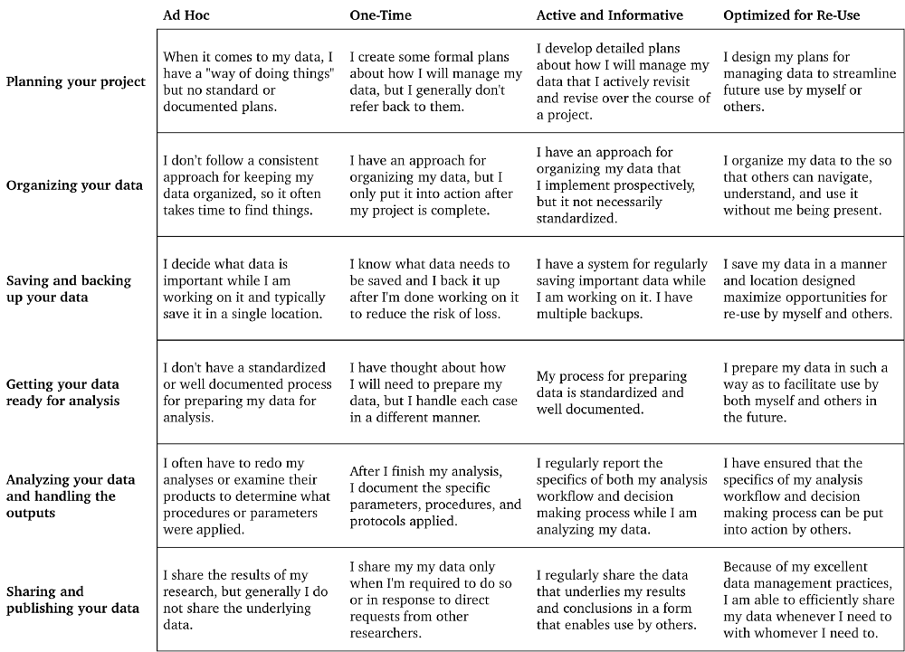
What data management practices do you apply in your research projects today?
Borghi, J. (2018). Support your Data. University of California Curation Center (UC3). https://uc3.cdlib.org/2018/01/11/support-your-data/

Slide 19



The Political Landscape
Policymakers are pushing for research data to be made available as openly as possible
Big investments are being made in infrastructure and skills for data sharing and reuse
Some motivating factors
Democratic principles
Good research practices
Societal and academic impact
Swedish Research Bill 2021–2024*
“
[…] research data shall be made accessible as open as possible and as closed as necessary
* Our translation from Swedish
“
The EU’s Open Science policy
FAIR […] open data sharing should become the default for the results of EU-funded scientific research

Slide 20

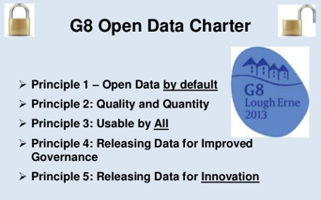

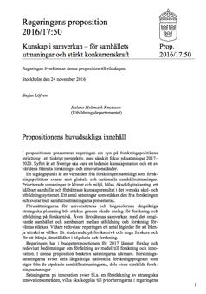
The Political landscape
Strong international movement towards Open Science
European Commission recommended the member states to establish national guidelines for Open Access
Swedish Research Council (VR) submitted proposal to the government Jan 2015
Research bill 2017–2020 – 28 Nov 2016
“The aim of the government is that all scientific publications that are the result of publicly funded research should be openly accessible as soon as they are published. Likewise, research data underlying scientific publications should be openly accessible at the time of publication.” [my translation]
2018 – VR assigned by the government to coordinate national efforts to implement open access to research data
Notes:
Why should you apply good data management practices and strive to make your research output FAIR?
Primarily because it will benefit your research. But there are other motivators.
Globally, there is an increasing demand at the political level for Open Science and FAIR.
Already in 2012, the European Commission recommended the member states to establish national guidelines for Open Access (publications and data). The Swedish Research Council (Vetenskapsrådet, VR) submitted a proposal to the government in 2015.
The government in the Research Bill of 2017 stated an ambition that “research data underlying scientific publications should be openly accessible at the time of publication”.
In 2018, VR was assigned by the government to coordinate national efforts to implement open access to research data.

Slide 21
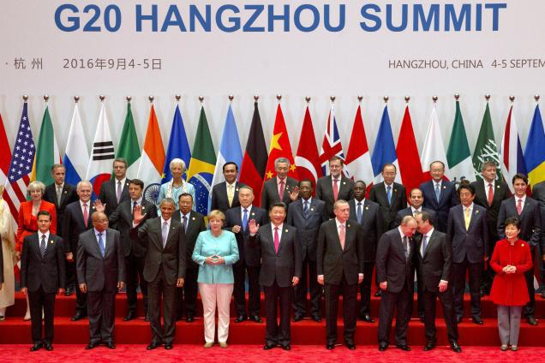
The Political landscape
‘We support appropriate efforts to promote open science and facilitate appropriate access to publicly funded research results on findable, accessible, interoperable and reusable (FAIR)’
Notes:
EU and the G20 have endorsed the FAIR principles.

Slide 22

EOSC
The EOSC will offer 1.7 million European researchers and 70 million professionals in science, technology, the humanities and social sciences a virtual environment with open and seamless services for storage, management, analysis and re-use of research data, across borders and scientific disciplines by federating existing scientific data infrastructures, currently dispersed across disciplines and the EU Member States.
https://www.eosc-portal.eu/
Notes:
EU has established the European Open Science Cloud (EOSC), that aims at being a trusted environment for sharing and analysing data from all publicly funded research.
Making the FAIR principles work is central to the realisation of this vision.

Slide 23
“Open Data Directive”
Directive (EU) 2019/1024 of the European Parliament and of the Council of 20 June 2019 on open data and the re-use of public sector information
To be implemented into national member state laws
"EU countries must adopt policies and take action to make publicly funded research data openly available, following the principle of ‘open by default’ and support the dissemination of research data that are findable, accessible, interoperable and reusable (the ‘FAIR’ principles)"
Notes:
There is also EU “Open data directive” (2019/1024) from June 2019, that is to be implemented into national member state laws by 16 July 2021.
The directive has writings about research data, and states that
“EU countries must adopt policies and take action to make publicly funded research data openly available, following the principle of ‘open by default’ and support the dissemination of research data that are findable, accessible, interoperable and reusable (the ‘FAIR’ principles)”.
A proposal about at Swedish Open Data law to implement this directive has been presented to the government in September 2020.

Slide 24
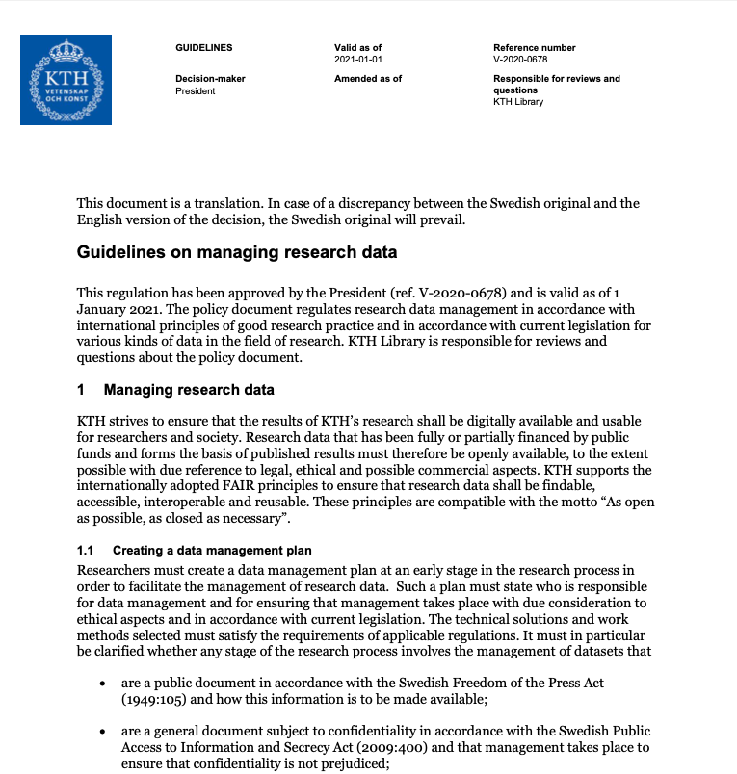
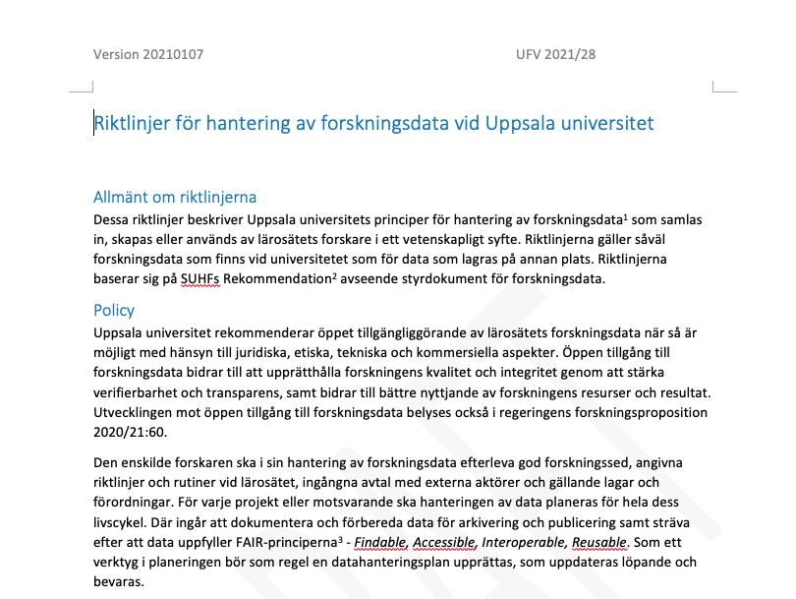
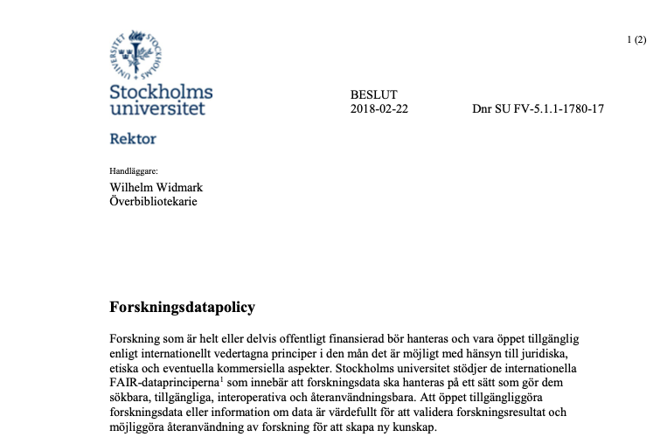
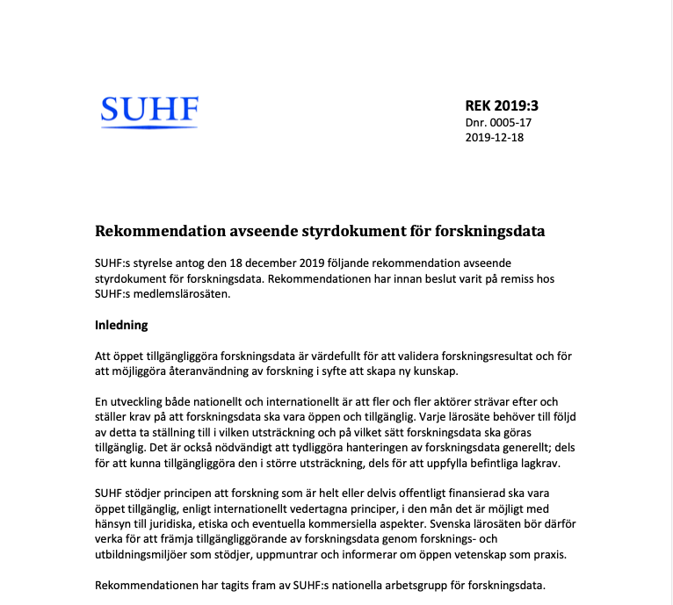
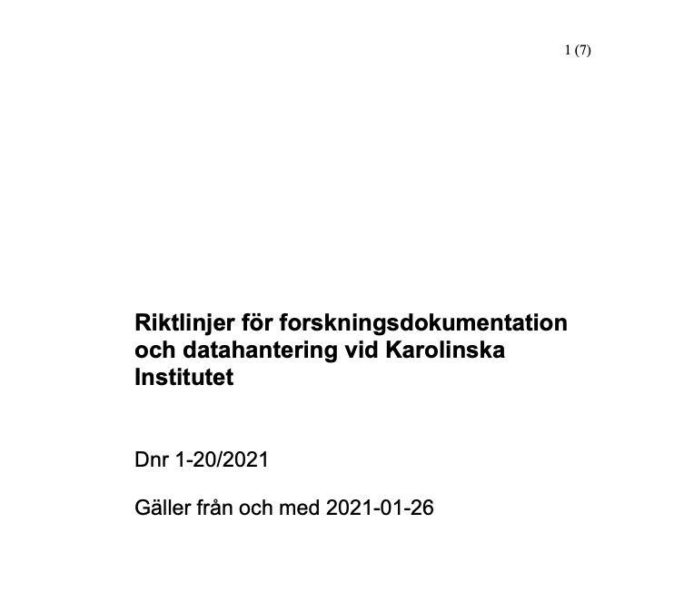
Funders
Data Management Plans
Open Data
Vetenskapsrådet, FORMAS, Riksbankens Jubileumsfond
Universities
Research Data Policies
Notes:
Funders are to a larger extent demanding that the data generated by research project that they fund is made available.
All future EU funding will demand data management planning where FAIR aspects are considered.
In Sweden, the VR, Formas, and Riksbankens jubileumsfond are demanding Data Management Plans for grants.
Universities are starting to establish research data policies (see e.g. Stockholm university) that calls for public access to publicly funded data, and the adherence to the FAIR principles

Slide 25
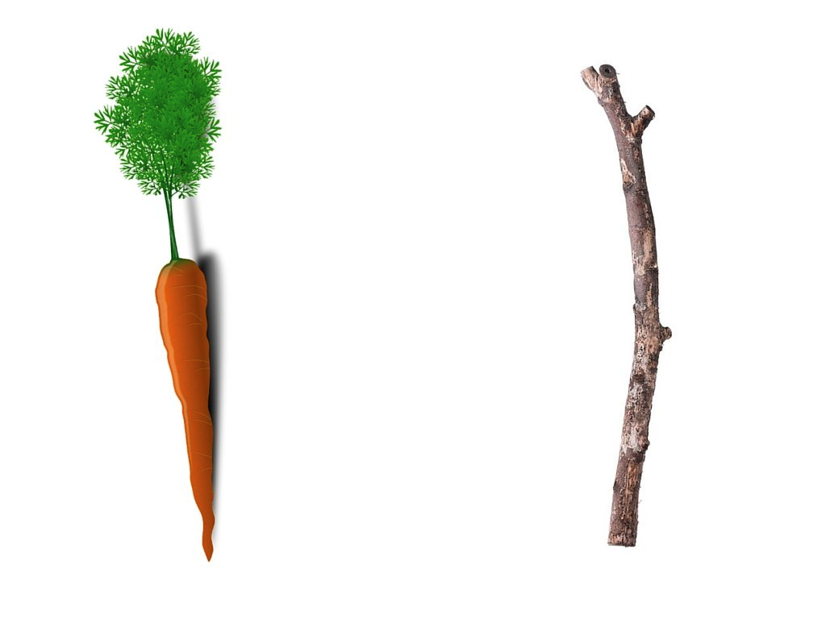
Motivators
Notes:
The political push for Open Science and FAIR can considered to be more of a stick than a carrot for researchers, but it will not become a reality if researchers don’t see the carrot, and if infrastructure and training are not available.
The aim of this course is to encourage you to use good Data Management practices to make your research easier in the long run, so that you can meet the emerging demands in this area from the society.

Slide 26
Good Data Management Practices
Data Management Plans, to do your thinking ahead of time
Using standard metadata descriptions, to clearly define your data
Organising your analysis, so you and others can understand what you have done
Use versioning control to keep track of changes you do
Clean up metadata and data to be consistent with the standards you have chosen
Submit your data to international public repositories, so others can find and reuse your data
Use scripted analysis of your data, that can be understood by others
Notes:
[Repeat of earlier slide]
See slide

